Slide 1
Two-Dimensional Conduction:
Flux Plots and
Shape Factors
Chapter 4
Sections 4.1 and 4.3

Slide 2
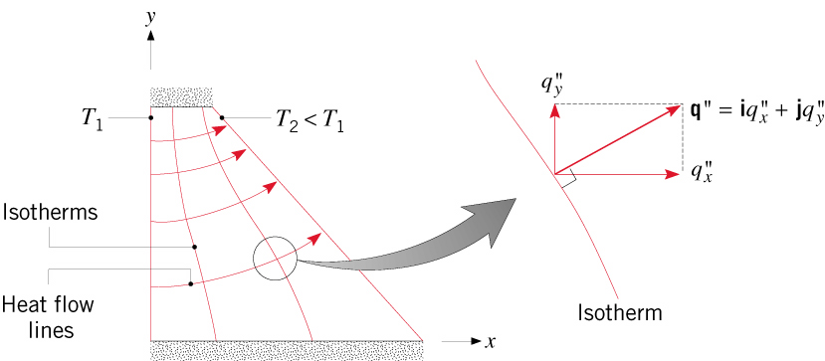
General Considerations
General Considerations
Two-dimensional conduction:
  Temperature distribution is characterized by two spatial coordinates,
  e.g., T (x,y).
  Heat flux vector is characterized by two directional components,
  e.g., and .
Heat transfer in a long, prismatic solid with two isothermal surfaces
and two insulated surfaces:
Note the shapes of lines of constant temperature (isotherms) and heat flow lines (adiabats).
What is the relationship between isotherms and heat flow lines?

Slide 3
Solution Methods
The Heat Equation and Methods of Solution
Assuming steady-state, two-dimensional conduction in a rectangular domain
with constant thermal conductivity and heat generation, the heat equation is:
Solution Methods:
Exact/Analytical: Separation of Variables (Section 4.2)
Limited to simple geometries and boundary conditions.
Approximate/Graphical : Flux Plotting
Of limited value for quantitative considerations but a quick aid to
establishing physical insights.
Approximate/Numerical: Finite-Difference, Finite Element or Boundary
Element Method.
Most useful approach and adaptable to any level of complexity.

Slide 4
Flux Plots
Flux Plots
Utility: Requires delineation of isotherms and heat flow lines. Provides a
quick means of estimating the rate of heat flow.
Procedure: Systematic construction of nearly perpendicular isotherms and heat
flow lines to achieve a network of curvilinear squares.
Rules:
On a schematic of the two-dimensional conduction domain, identify all
lines of symmetry, which are equivalent to adiabats and hence heat flow lines.
Sketch approximately uniformly spaced isotherms on the schematic,
choosing a small to moderate number in accordance with the desired
fineness of the network and rendering them approximately perpendicular
to all adiabats at points of intersection.
Draw heat flow lines in accordance with requirements for a network
of curvilinear squares.

Slide 5
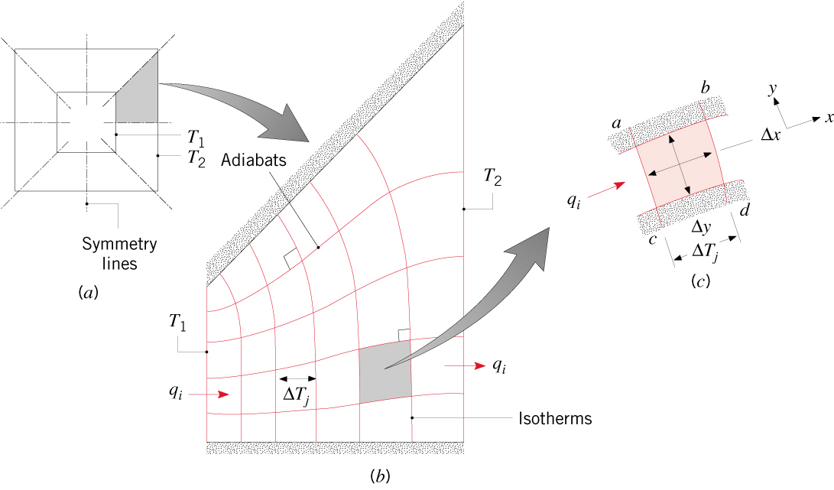
Flux Plots (cont.)
Example: Square channel with isothermal inner and outer surfaces.
Note simplification achieved by identifying lines of symmetry.
Requirements for curvilinear squares:
Intersection of isotherms and heat flow lines at right angles
Approximate equivalence of sums of opposite sides
(4.20)
Determination of heat rate:
(4.24)

Slide 6
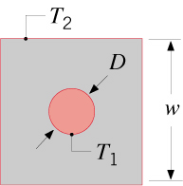
Shape Factor
The Conductor Shape Factor
Two-dimensional heat transfer in a medium bounded by two isothermal
surfaces at T₁ and T₂ may be represented in terms of a conduction shape
factor S.
(4.25)
For a flux plot,
(4.26)
Exact and approximate results for common two-dimensional systems are
provided in Table 4.1.
For example,
Case 6. Long (L>>w) circular
cylinder centered in square
solid of equal length
Two-dimensional conduction resistance:
(4.27)

Slide 7
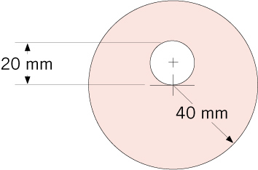
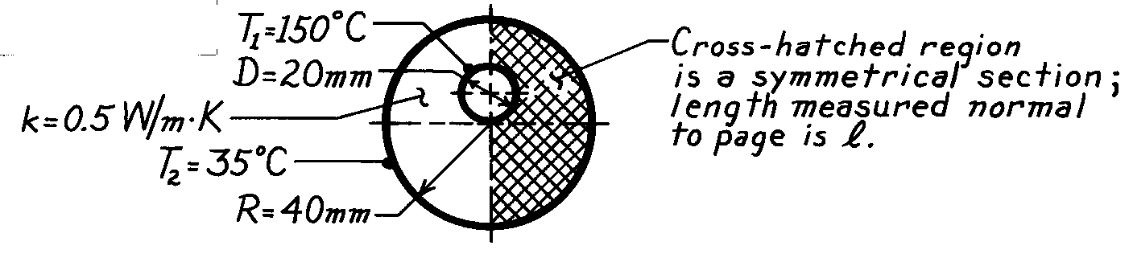
Problem: Flux Plot
Problem 4.6: Heat transfer from a hot pipe embedded eccentrically
in a solid rod.
Schematic

Slide 8
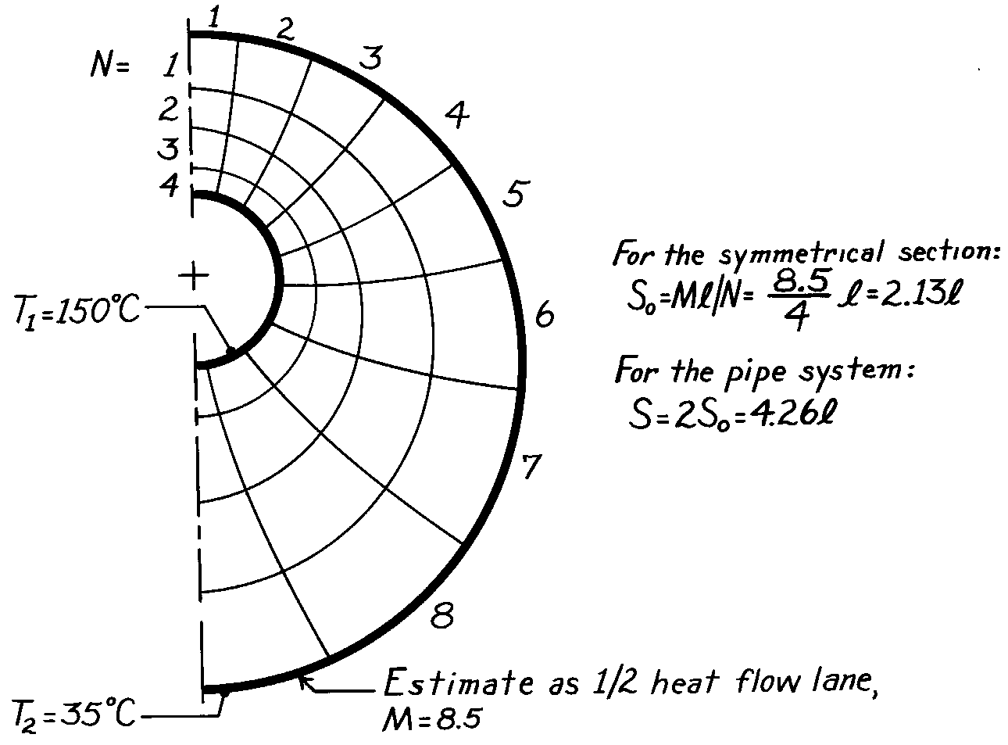
Flux Plot
Determine the error associated with the flux plot by using a result from Table 4.1
to compute the actual value of the shape factor.

Slide 9
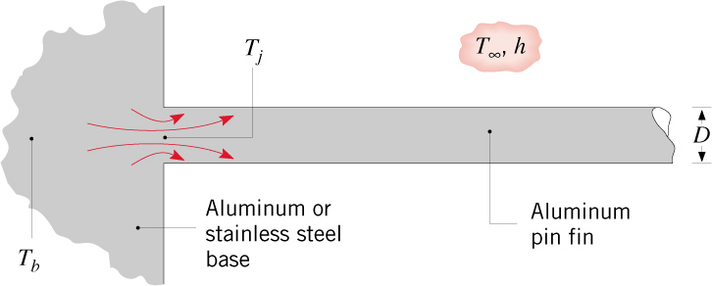
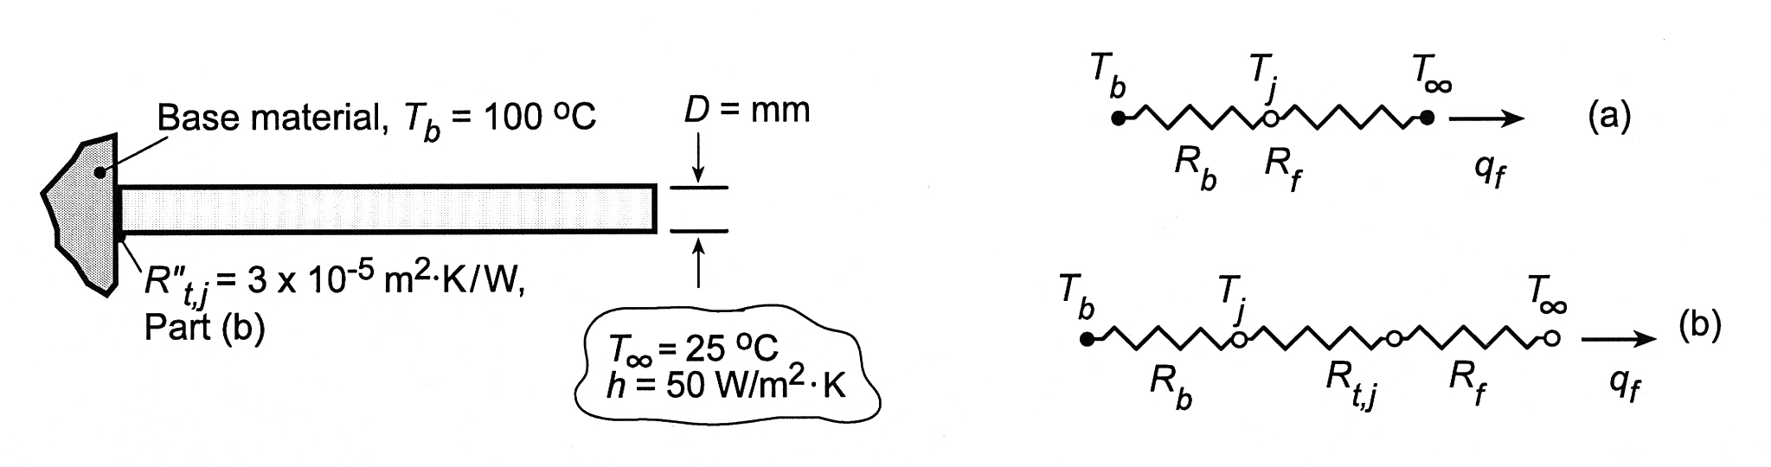
Problem: Shape Factor
Problem 4.27: Attachment of a long aluminum pin fin (D=5mm) to a
base material of aluminum or stainless steel. Determine
the fin heat rate and the junction temperature (a) without
and (b) with a junction resistance.
Schematic:

Slide 10
Problem: Shape Factor (cont)

Slide 11
Problem: Shape Factor (cont.)

